Slide 1
LAB 5

Slide 2

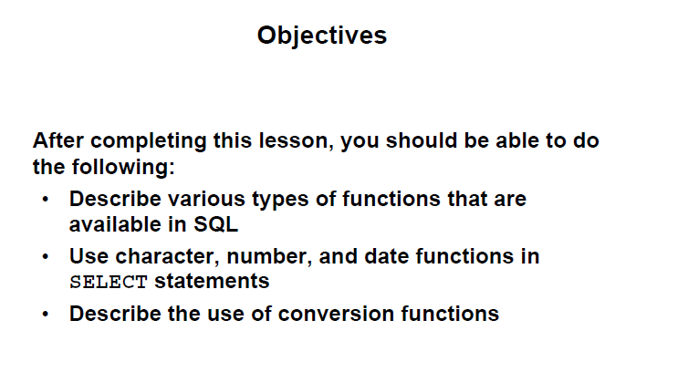

Slide 3
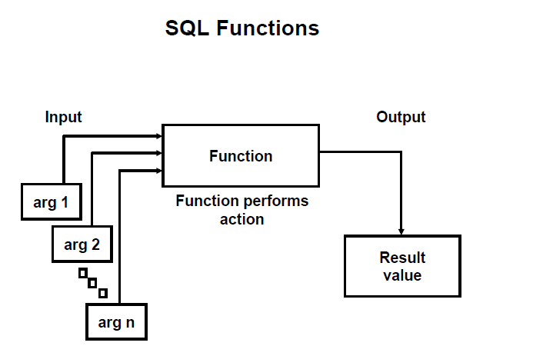

Slide 4
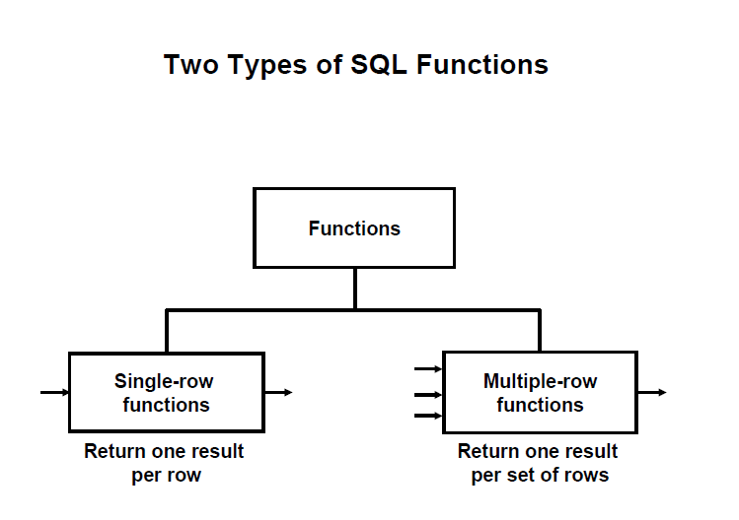

Slide 5
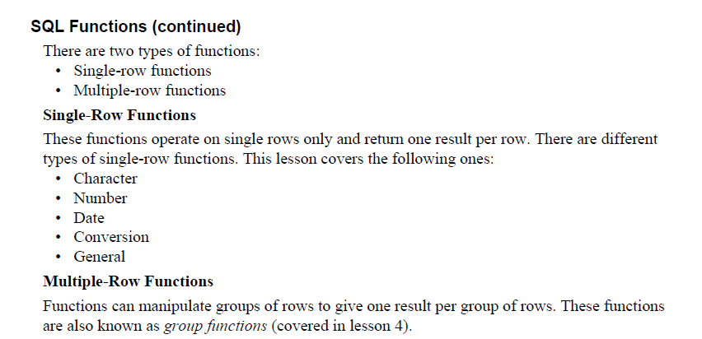

Slide 6
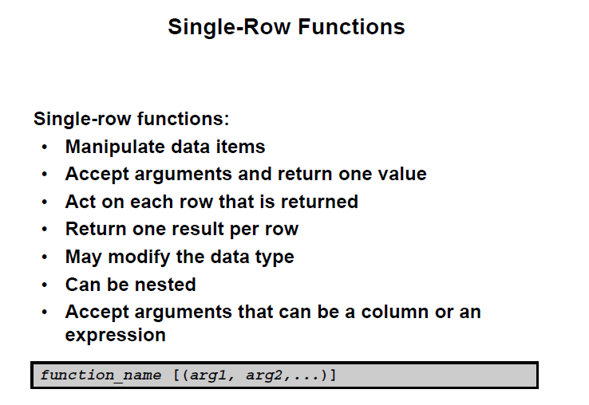

Slide 7
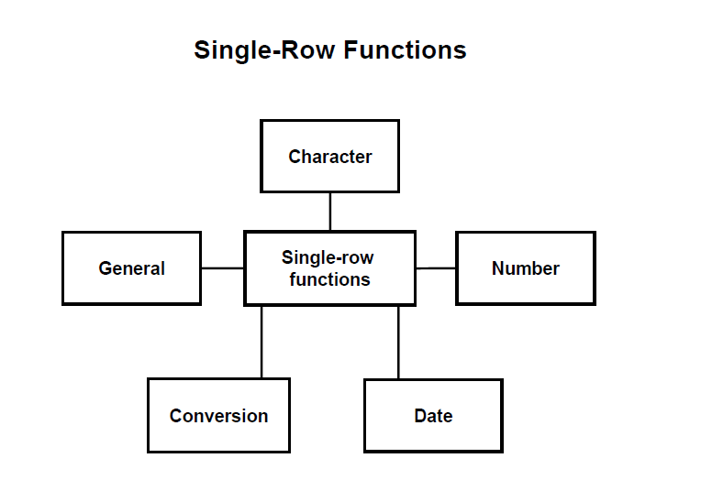

Slide 8
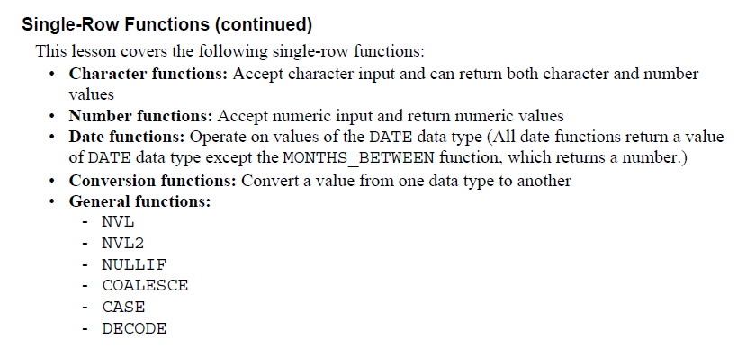

Slide 9
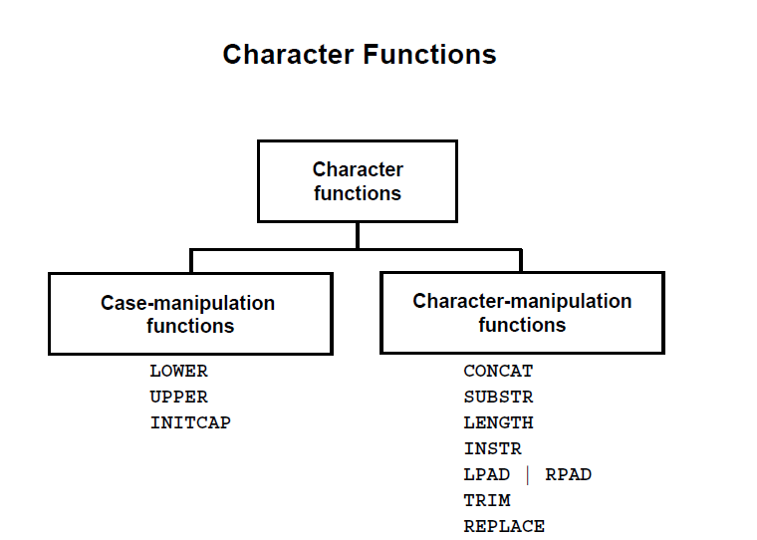

Slide 10
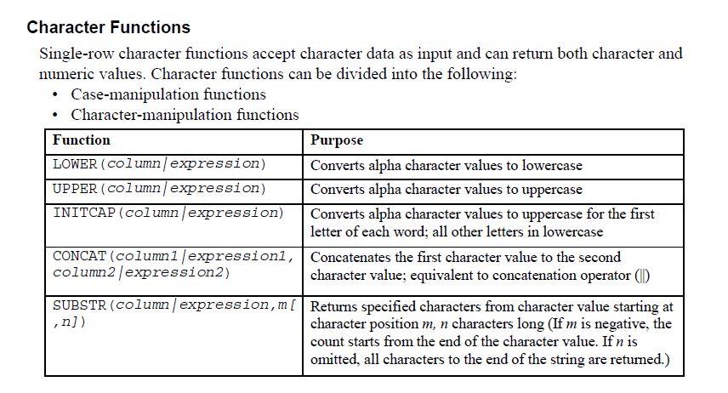

Slide 11
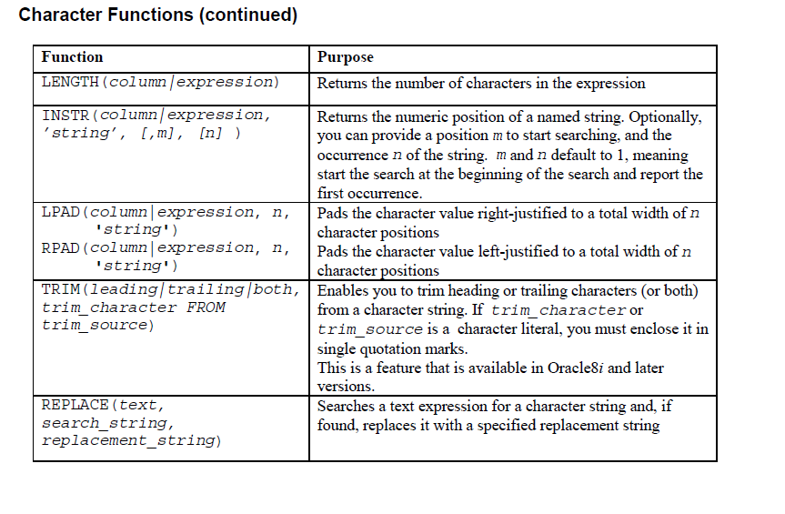

Slide 12
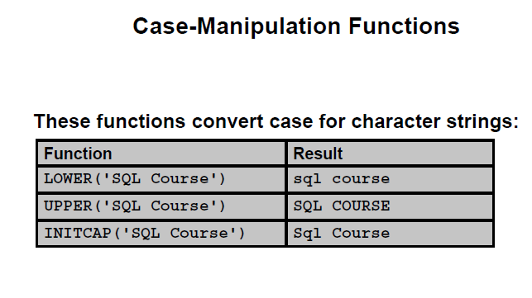
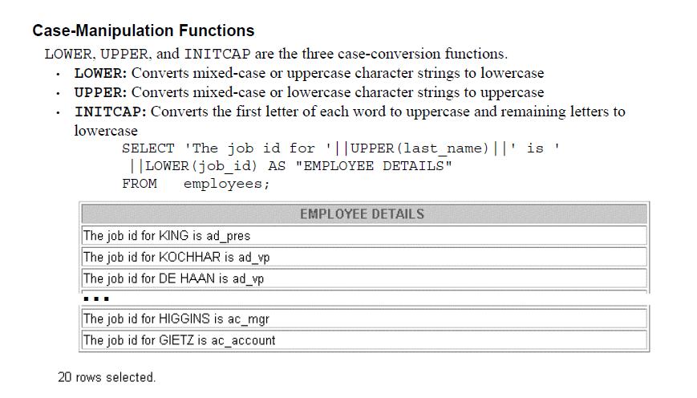

Slide 13
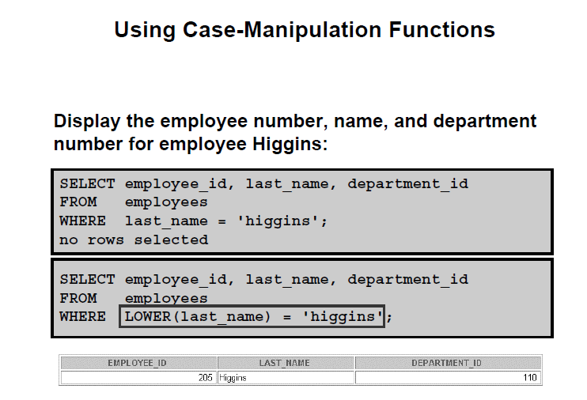

Slide 14
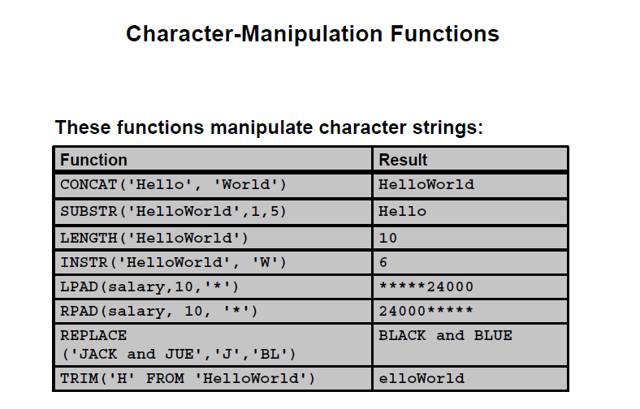

Slide 15
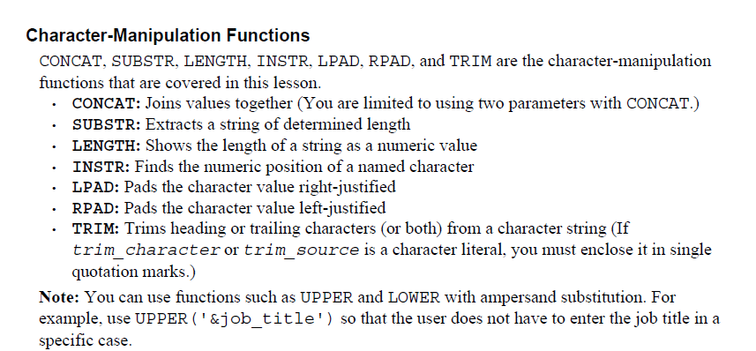

Slide 16
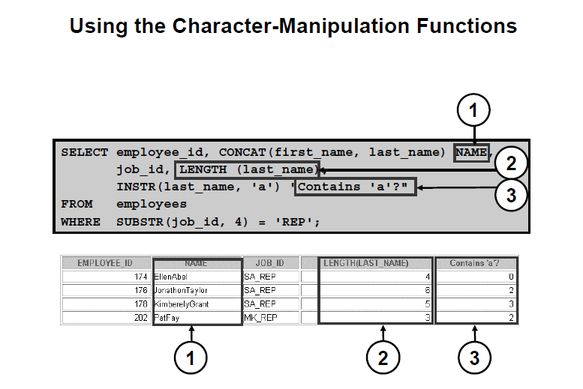

Slide 17
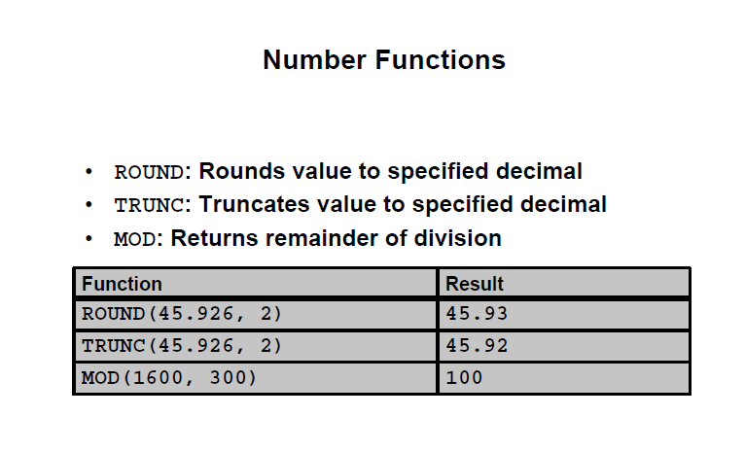

Slide 18
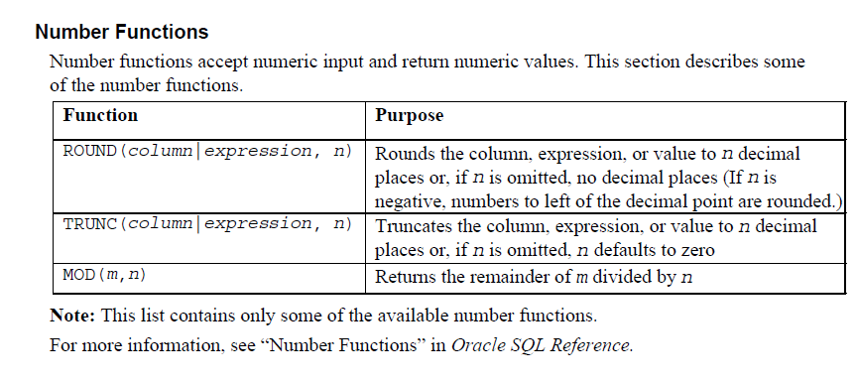

Slide 19
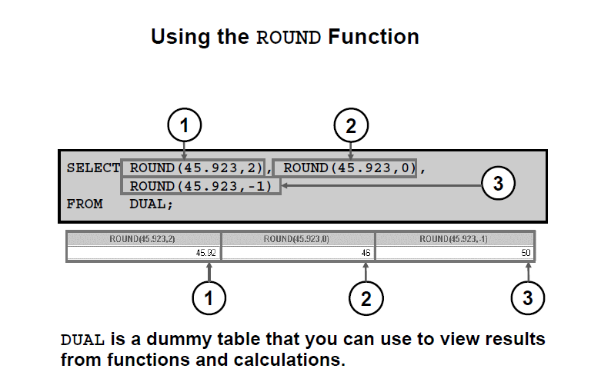

Slide 20
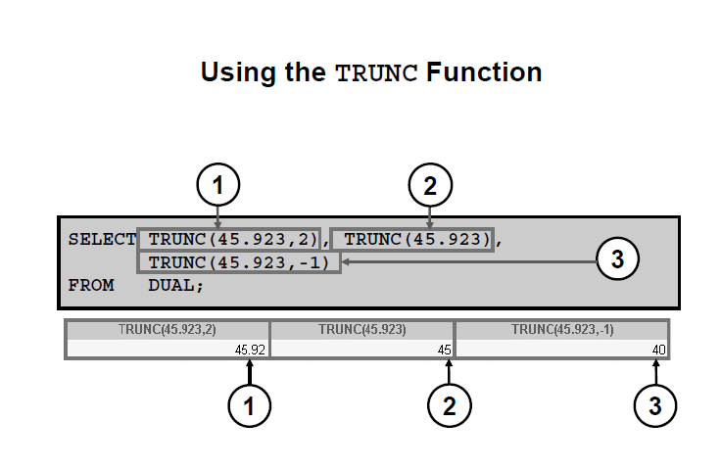
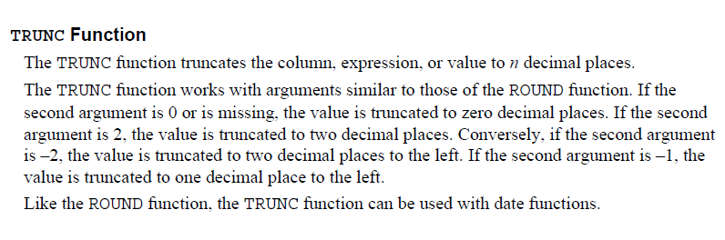

Slide 21
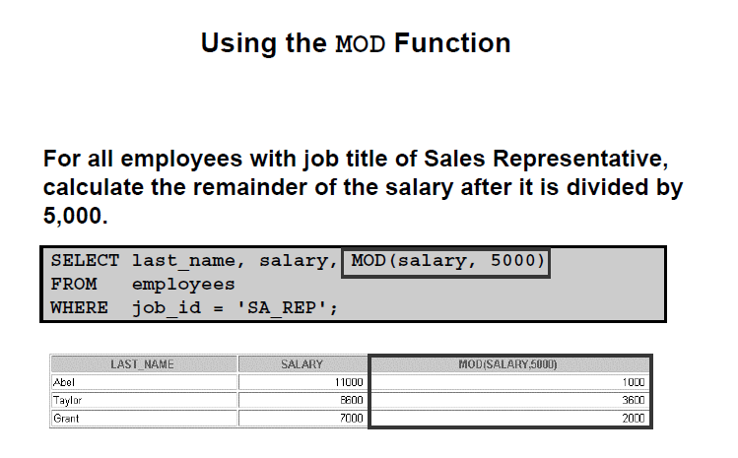

Slide 22
EXERCISE

Slide 23

Display all employee last names in which the third letter of the name is a.
Display the last name, job, and salary for all employees whose jobs are either sales representative or stock clerk and whose salaries are not equal to $2,500, $3,500, or $7,000
Modify your query lab_03_02.sql to add a column that subtracts the old salary from the new salary
Write a query that displays the last name (with the first letter uppercase and all other letters
lowercase) and the length of the last name for all employees whose name starts with the letters J, A, or M. Give each column an appropriate label. Sort the results by the employees’ last names.
Create a query to display the last name and salary for all employees. Format the salary to be 15 characters long, left-padded with the $ symbol. Label the column SALARY.
Display each employee’s last name, hire date, and salary review date, which is the first Monday after six months of service. Label the column REVIEW. Format the dates to appear in the format similar to “Monday, the Thirty-First of July, 2000.”

